Slide 1


Department of Computer Science and Engineering
BIKE PRICE PREDICTION
Mrs. M.Divya, M.E
Department of Cse
2116220701197
Prannov Shabari N

Slide 2
Problem Statement and Motivation
In the Indian second-hand two-wheeler market, both buyers and sellers often struggle to estimate the fair market price of a used bike due to numerous influencing factors such as city, ownership history, brand, usage, age, and engine power. This lack of standardized pricing leads to unfair deals and a lack of trust among stakeholders.
The objective of this project is to develop a web-based application that predicts the estimated resale price of a used bike using machine learning models trained on real-world data. The solution provides a user-friendly interface to input bike details and returns a price prediction, thus aiding users in making informed buying or selling decisions.

Slide 3
Existing System
With the rapid digitization of the used vehicle market in India, several platforms like OLX Autos, Droom, BikeDekho, and CredR offer solutions for buying, selling, and estimating the value of second-hand bikes.
OLX Autos (https://www.olx.in)
Offers used bike listings and provides a rough price range.
Relies on seller inputs and market trends rather than advanced ML models.
Lacks personalized prediction based on detailed bike parameters.
BikeDekho (https://www.bikedekho.com)
Focused more on new bike models, but also features used bike pricing.
Uses market comparison instead of intelligent prediction.
No real-time or interactive price prediction model for individual listings.

Slide 4
Objectives
The objective of this project is to develop a machine learning-based web application that accurately predicts the resale price of used bikes based on key input features such as city, brand, kilometers driven, engine power, and age of the bike.
By leveraging real-world data and advanced regression techniques, the system aims to provide a personalized, transparent, and user-friendly solution for buyers and sellers to make informed pricing decisions in the Indian second-hand two-wheeler market.

Slide 5
Abstract
In India second-hand two-wheeler market, determining the fair resale value of a used bike is often challenging due to the lack of standardized pricing mechanisms. Factors such as city of registration, brand, usage in kilometers, engine power, and bike age significantly influence the price, yet most platforms rely on generalized or static price estimates.
This project proposes a machine learning-based web application that enables users to predict the resale price of a used bike accurately. Using a real-world dataset and the XGBoost regression algorithm, the model is trained to learn from both categorical and numerical features. The application is built using Python, Flask, and HTML/CSS, providing a simple interface for users to input bike details and receive a dynamic price prediction.

Slide 6
Proposed System
The proposed system is a machine learning-powered web application designed to predict the resale price of used bikes based on multiple user-defined input features. Unlike existing platforms that offer generic or non-transparent pricing, this system leverages a trained regression model to provide accurate and personalized predictions.
The system uses a real-world dataset of used bikes containing attributes such as city, ownership history, brand, kilometers driven, engine power, and age. It applies the XGBoost Regressor, a powerful gradient boosting algorithm, combined with preprocessing techniques like one-hot encoding for categorical features.
The application is built using the Flask web framework, allowing users to enter relevant bike information through a clean and responsive web interface. Upon form submission, the input data is processed and passed to the trained machine learning model, which returns an estimated resale price.

Slide 7
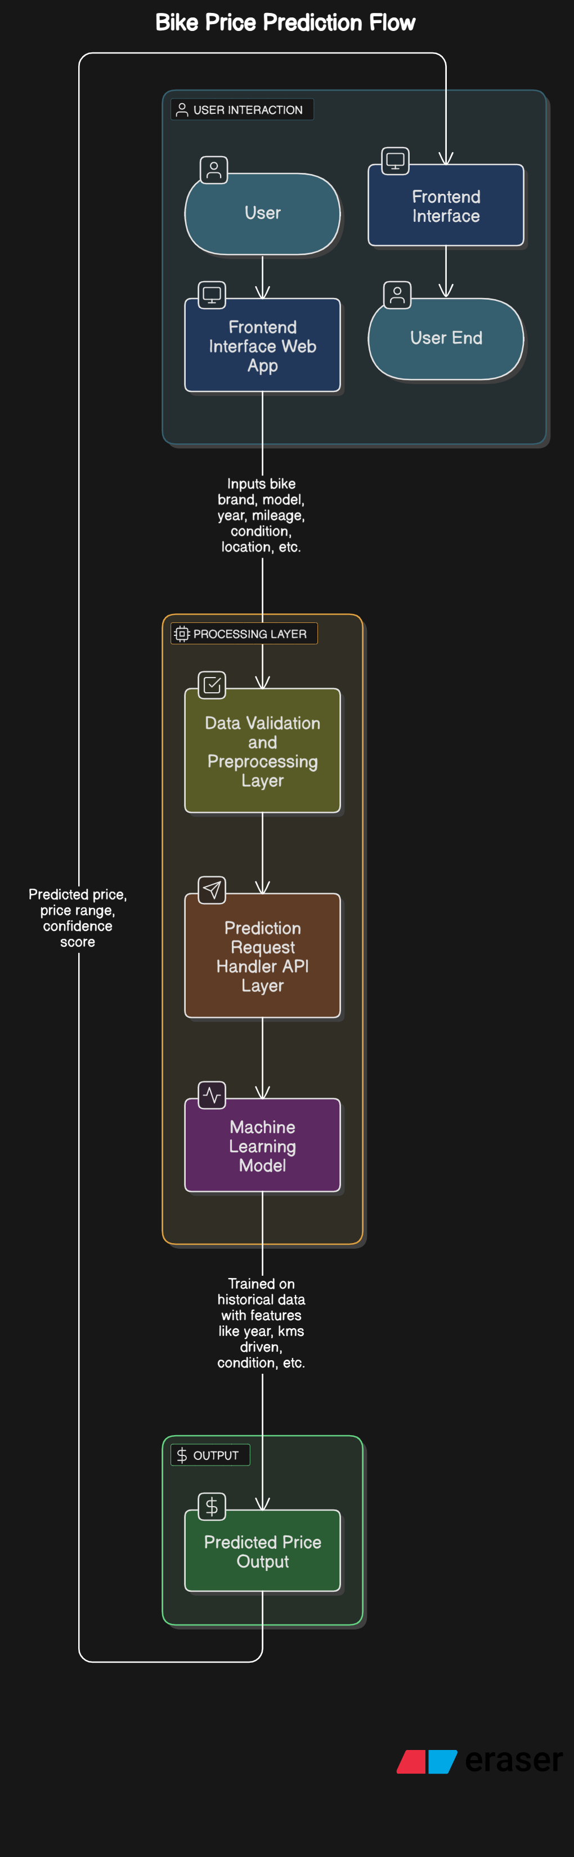
System Architecture

Slide 8
List of Modules
1. Web App (app.py)
Runs the Flask server
Loads model & handles predictions
2. Model Training (model_training.py)
Trains XGBoost model using bike data
Saves model (bike_price_model.pkl)
3. Frontend (index.html)
User form to input bike details
Shows predicted price
4. Dataset (Used_Bikes.csv)
Data for training & dropdown options
5. Saved Model (bike_price_model.pkl)
Used for predicting bike prices

Slide 9
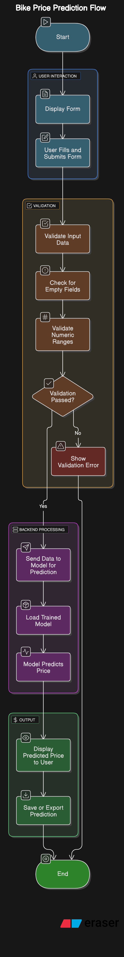
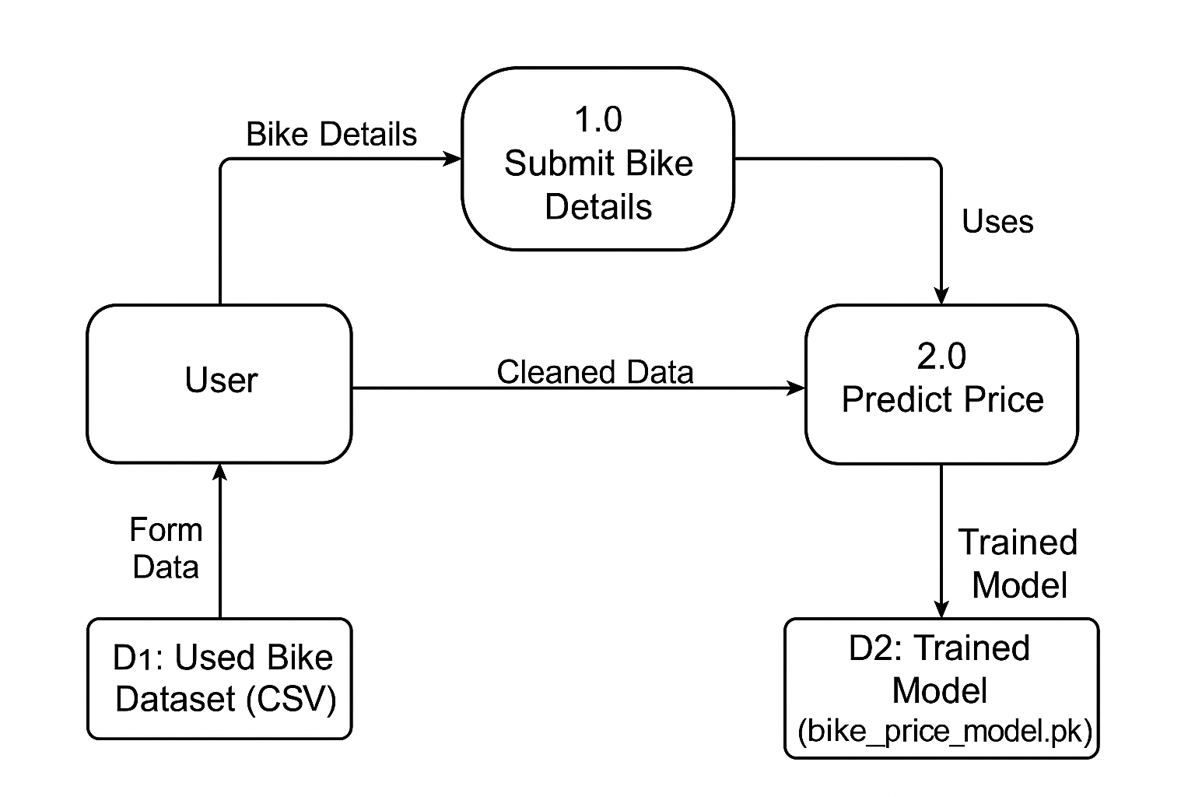
Functional Description for each modules with DFD and Activity Diagram

Slide 10
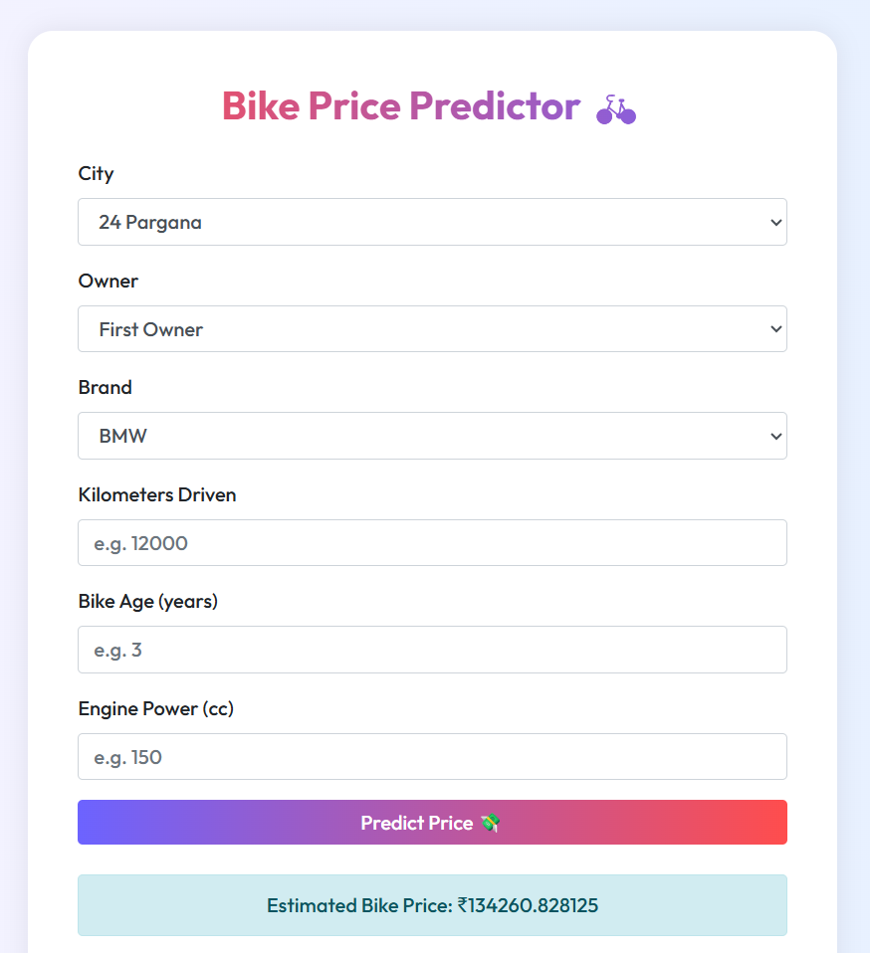
Implementation & Results of Module

Slide 11
Conclusion & Future Work
The project presents a practical and intelligent solution for estimating the resale price of used bikes using machine learning. By analyzing key factors such as city, brand, kilometers driven, engine power, and age, the system provides an accurate and data-driven price prediction. The integration of the XGBoost regression model ensures high performance and reliability, while the Flask-based web interface allows users to easily interact with the system in real time.
This approach addresses the limitations of existing platforms by offering greater transparency, personalization, and accuracy. Users no longer need to rely on vague market estimates or third-party suggestions—instead, they can make informed decisions based on objective data and machine learning insights. Overall, the project successfully combines modern data science techniques with web development to solve a real-world problem in the Indian two-wheeler market.

Slide 12
References
1. M. Patel, R. Sharma, and S. Banerjee, "Predicting Used Bike Prices Using
Machine Learning Techniques, “International Journal of Computer Applications, vol. 182,
no. 46, pp. 35–41, 2021.
2. Y. Gupta and A. Verma, "Price Estimation of Second-Hand Bikes Using Ensemble
Learning Models," Journal of Data Science and Applications, vol. 14, no. 2, pp. 89–98,
2020.
3. S. Singh, P. Kumar, and K. Jain, "A Comparative Study of Regression Models for
Vehicle Price Prediction," International Journal of Artificial Intelligence and Machine
Learning, vol. 9, no. 3, pp. 145–157, 2022.
4. H. Zhang, T. Li, and J. Wang, "Bike Price Prediction Using XGBoost and Feature
Engineering Techniques, " IEEE Access, vol. 10, pp. 20185–20194, 2022.

Slide 13
Paper Publication Status
The paper based on this project is done and is planned to be submitted to a reputed journal or conference specializing

Slide 14
Thank You

